Slide 1
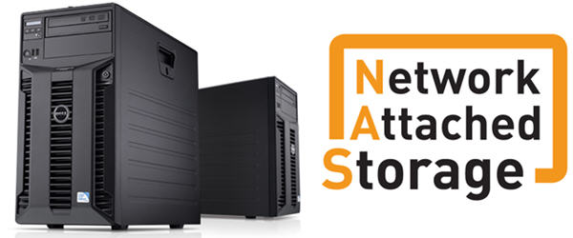

Slide 2
A storage device, which is attached directly to a network is called as Network Attached Storage.
NAS provides file access services to computer system and acts like a storage element-SNIA(Storage Network Industry Association).

Slide 3
Introduction
NAS is used to access and to store different type of data over a network.
NAS systems are networked appliances which contain one or more storage drives, often arranged into logical, redundant storage containers .
Have its own LAN IP address for RAID configuration, which is attached to the administrator computer that provide applications to network workplace clients.
Provide access to files using network file sharing protocols such as NFS, SMB/CIFS, or AFP.

Slide 4
NAS Components
Data reception component
Data interception component
Intermediate component
Data identification component

Slide 5
NAS Functions
File sharing
Data backup/disaster recovery
Network printing
Multimedia file sharing
Media server

Slide 6
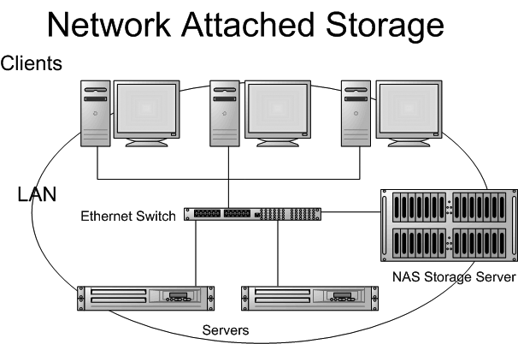
NAS Architecture

Slide 7
Logical Unit Number
In computer storage, a logical unit number, or LUN, is a number used to identify a logical unit, which is a device addressed by the SCSI protocol or Storage Area Network protocols.
Zoning
In a storage area network (SAN), zoning is the allocation of resources for device load balancing and for selectively allowing access to data only to certain users.
Essentially, zoning allows an administrator to control who can see what in a SAN.

